Slide 1
PLC for Home Automation and How to Make It a Honeypot
Philippe Lin (@miaoski)
For BSidesLV 2016
* Special thanks to Ming-Wei Cheng for his PLC-enabled house.
* Thanks Scott Erven for being my mentor ☺

Slide 2
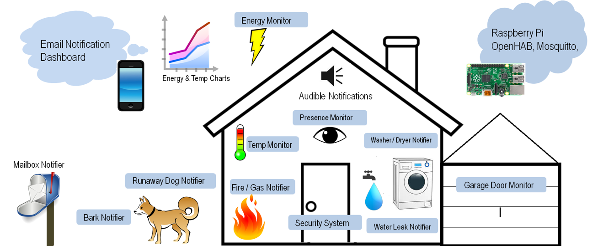
Home Automation
https://hackaday.io/post/4337
Notes:
Eric Tsai, Wireless home automation with OpenHAB
Awesome design, $20 arduino + Raspberry Pi + RF69M

Slide 3

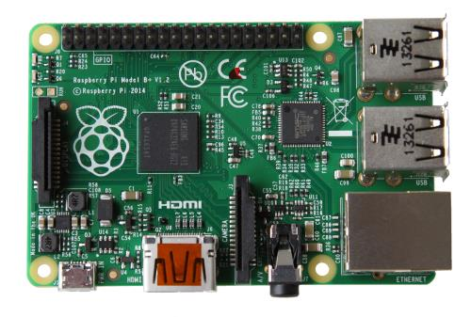
PLC for Reliability
Robust – 20 years
Install and forget
IFTTT and HMI (optional)
Notes:
Reliability, maintenance cost
Work in the sands

Slide 4
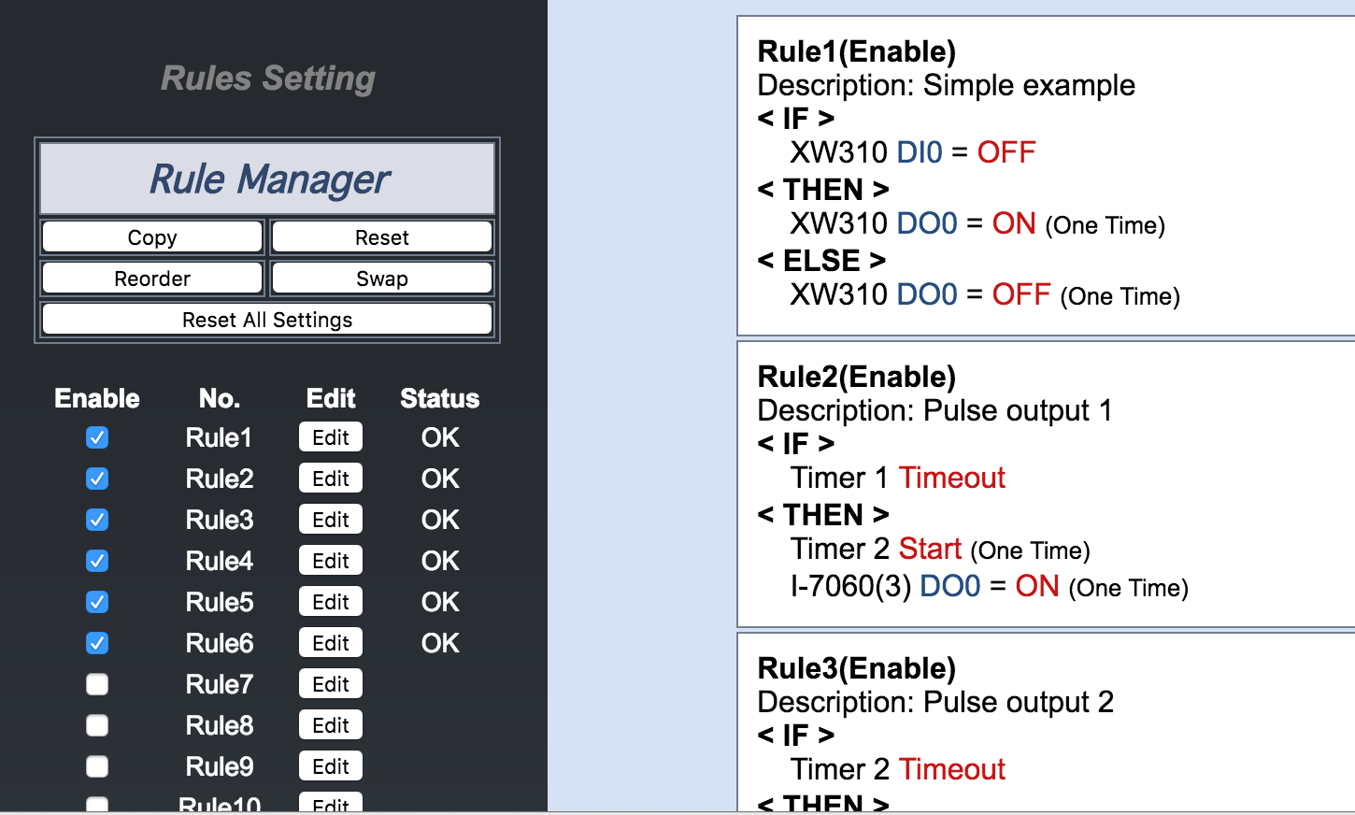
IFTTT
Notes:
Equivalent to Arduino progs, just simpler
My friend’s house

Slide 5

As You Enter the House ...
Infrared Sensor
Notes:
IR → Remote controller to unlock keyless system

Slide 6
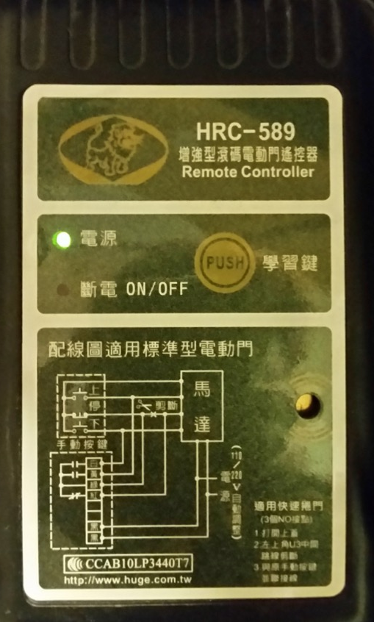
As You Enter the House ...
Rolling code Remote Controller
Notes:
Prevents replay attack – Common PRNG and compares within next 256 codes (Wikipedia)

Slide 7

As You Enter the House ...
Reed Switch

Slide 8


> 100 dB Siren Buzzes, When ...
You passed the IR sensor, but failed to unlock rolling code controller within 1 min.
Reed switches on doors and windows turn on.
Any circuit got cut
Moreover ...

Slide 9
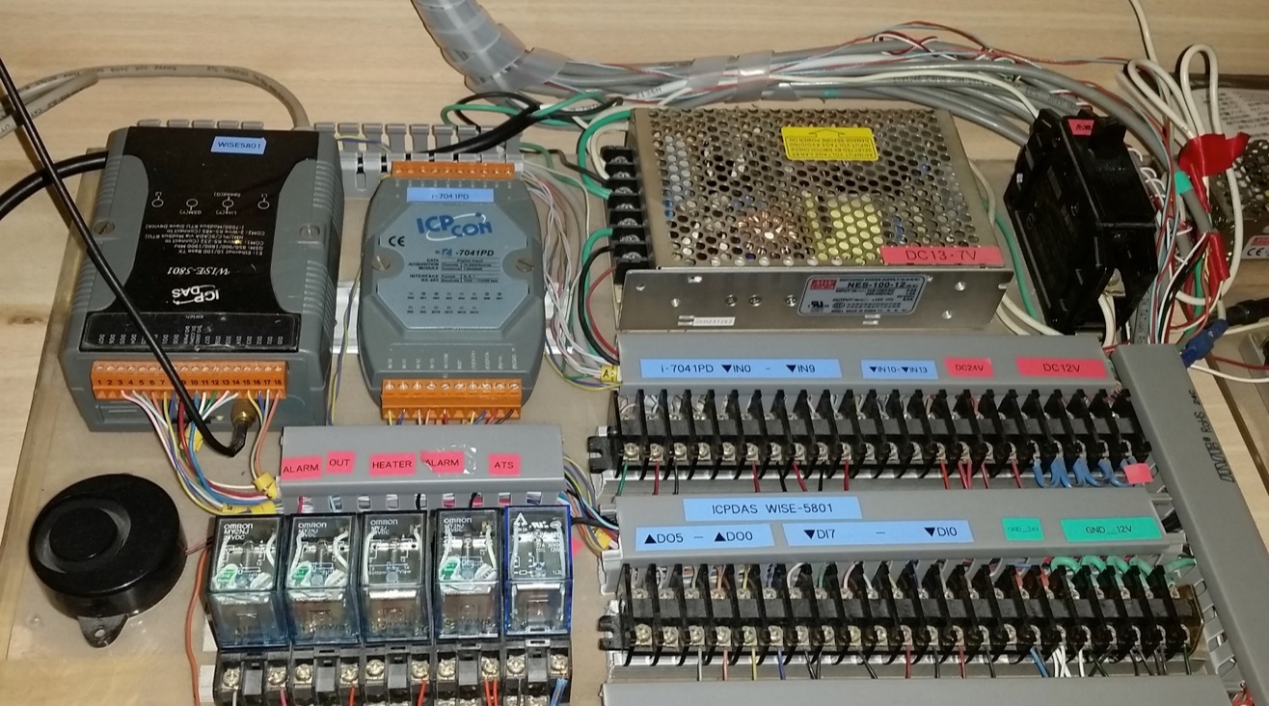
UPS and Double-Loop
Backup Power
ModBus/TCP
GPRS
RS485
24V
12V
Alarm
16 DI
Omron relays
DI from reed switches
Notes:
ICP DAS

Slide 10
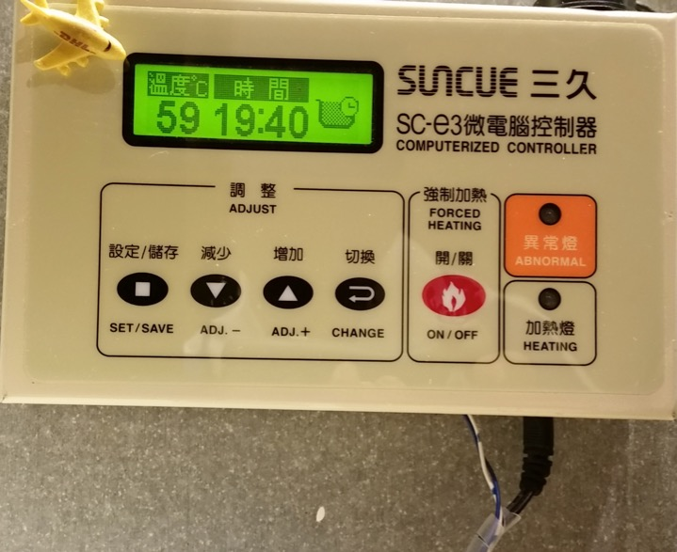
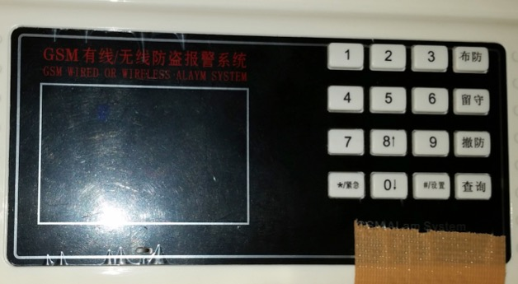
Heater and Backup Alarm
GSM Alarm
Sends SMS when PLC is broken, DoS, etc.
Turn on the boiler
before he drives home
RS485
Monitors PLC’s heart beat
Notes:
GSM Alarm – When PLC malfunctions

Slide 11
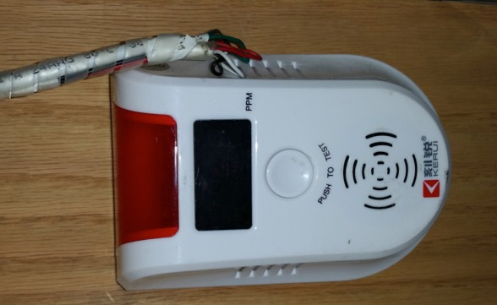
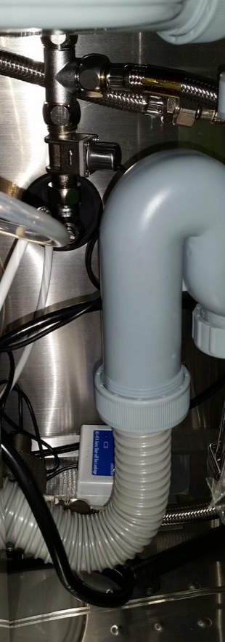

Peripherals
Solenoid Valve
Gas Sensor
Leak Detector
Patrol Helicopter

Slide 12
Wiring
ICP Con i7041PD
IN 0 Reed 6
IN 1 Reed 7
IN 2 Reed 8
IN 3 x
IN 4 x
IN 5 Reed 9
IN 6 Reed 10
IN 7 Reed 11
IN 8 Gas sensor
IN 9 Water leak
IN 10 x
IN 11 x
IN 12 x
IN 13 Reed 12
RS485 ICP DAS
Heater
ICP DAS Wise-5801
DO 0 Relay 1
DO 1 Relay 2
DO 2 Relay 3
DO 3 Relay 4
DO 4 x
DO 5 x
DO 6 x
DO 7 x
DI 0 IR Sensor
DI 1 Key lock
DI 2 Reed 1
DI 3 Reed 2
DI 4 x
DI 5 Reed 3
DI 6 Reed 4
DI 7 Reed 5
RS485 ICP CON
Email + SMS
24V DC + 12V DC Backup
Omron Relays
#1 Alarm (NC)
#2 Out
#3 Heater
#4 Alarm (NC)
#5 ATS
Backup power for peripherals
Sancue Heater
Power
RS485
Resets GSM Alarm
Notes:
IN => Pulled high when closed, LOW = trigger

Slide 13
How to Break Into the House?
Trigger IR Sensor without key lock → Bam!
Open door / windows without key unlock → Bam!
Cut off AC power → UPS backup
Short circuit because it’s low triggered → Maybe
Hack into VPN → Maybe
Send a phishing email to get IP address
Asus home router vulnerability
Stop countdown timer
Change ModBus settings
DoS PLC
Sends email when door is opened
Buzz when PLC resets
SMS when PLC stops heartbeat
Notes:
No glass vibration alarm

Slide 14
How to Break Into the House?
Murphy’s law!
Anything that can go wrong, will go wrong.
UPS power-rail fails
Backup UPS power-rail fails, too.
Smash and grab!
Few more minutes to cut the wire mesh glass.
Break the PRNG in rolling code
Replay attack ➔ Samy Kamkar in DEFCON23.
Use acetylene cutter
Notes:
Thieves might want to choose another house (mesh glass)

Slide 15
So, what’s next, if the house is robust?

Slide 16
1-Level Honeypot
Discrete input = Window open / close
Coils = Lamps or water faucets
Input registers = temperature, humidity
Holding registers = target temperature
Add some camouflage and make it look like some industry?
https://www.trendmicro.com/vinfo/us/security/news/
cybercrime-and-digital-threats/the-gaspot-experiment
Notes:
After having a super secure house, we make it a source of hour honeypot

Slide 17
1-Level Honeypot Architecture
PLC at Home
ModBus TCP/502
Copy the readings every t seconds
Intermediate ModBus
(Exposed)
K wants to
change the coils
Log the changes
Display on
HMI written in Python
(Exposed)
K browses the HMI and feels happy
It’s not very interesting to simply copy the readings, though.
Notes:
Smith K, check Franz Kafka.

Slide 18
2-Level Honeypot
Self-adaptive honeypot (?)
States change in a predefined way, yet readings will match PLC@home.
Procrastinated
Incremental
Change in a given rate
Can deploy multiple honeypots and change fuzzy factors (ransom seeds, changing rate)
How about binding a pseudo-pump?

Slide 19
2-Level Honeypot Architecture
PLC at Home
ModBus TCP/502
Fuzzily matches the readings to
Intermediate ModBus
exposed on Internet
K wants to
change the coils
Log the changes
Display on
HMI written in Python
(read only)
K browses the HMI and feels happy
Notes:
Smith K, of course

Slide 20
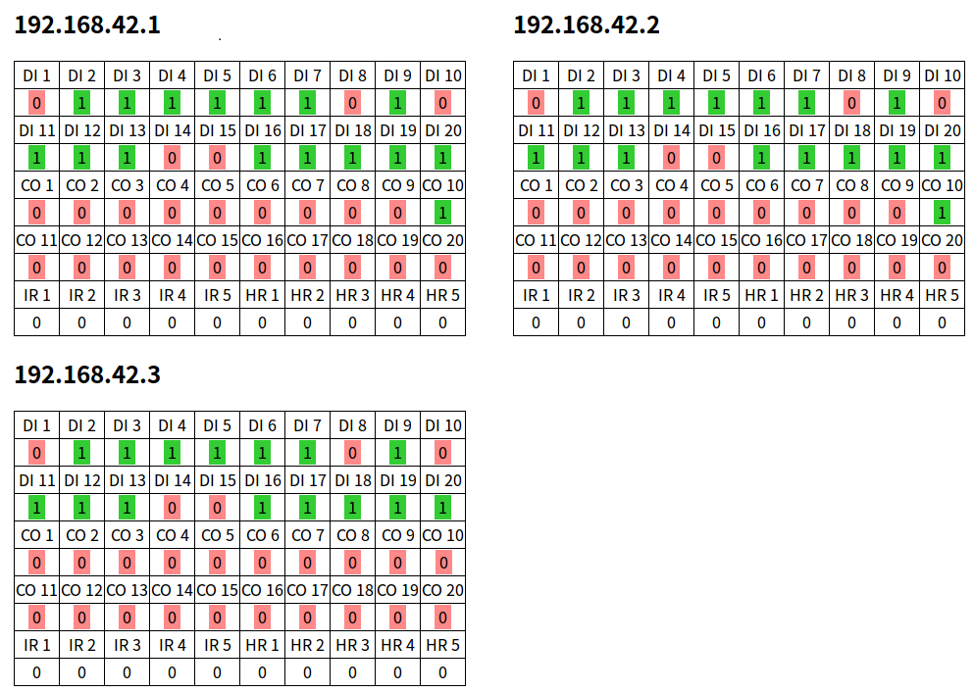
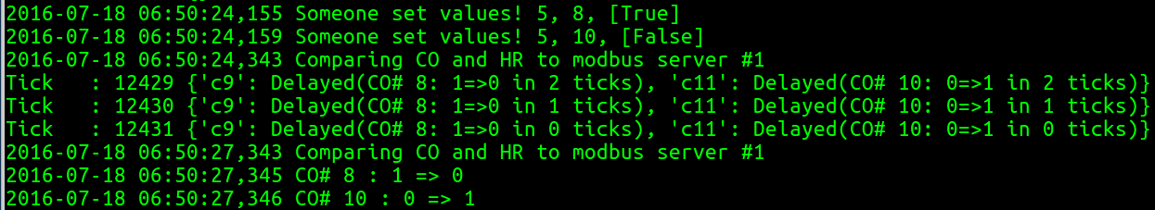
Ground Truth (PLC)
1-Level Honeypot
2-Level Honeypot
Heart beat pin
If someone sets CO#8 and CO#10
Delayed

Slide 21
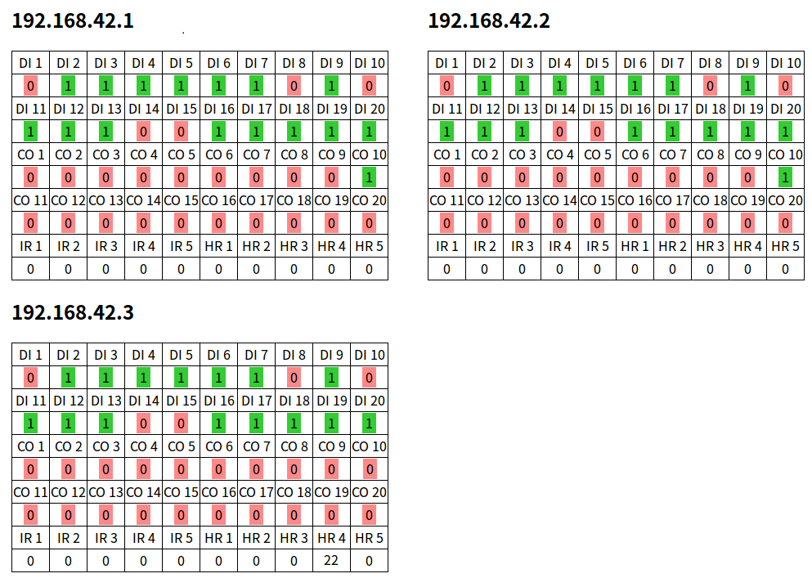
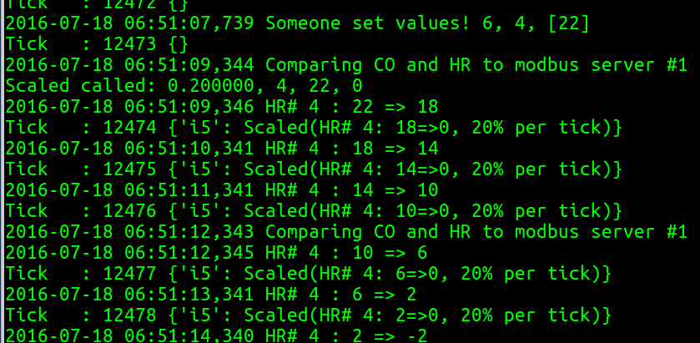
Ground Truth (PLC)
1-Level Honeypot
2-Level Honeypot
Scaled fallback to ground truth

Slide 22
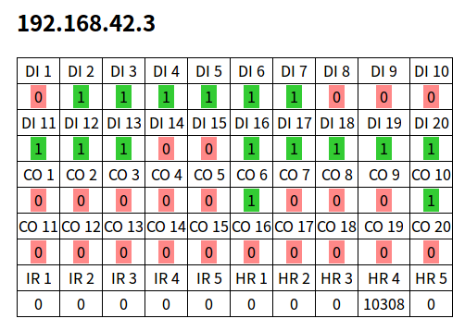

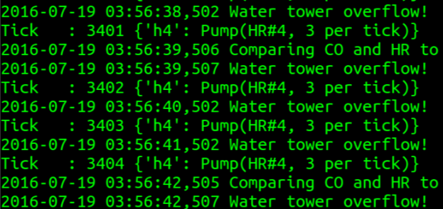

Simulate a Pump
DI#7
Increases until DI#7 goes low
CO#6
DI#6
Notes:
In 20 lines of Python

Slide 23
Recap
PLC with double loop for robust home security.
Simple honeypot that copies from PLC.
Adaptive honeypot that copies from PLC.
Simulate a pump or other circuits based on PLC.
Codes and materials: https://github.com/miaoski/bsideslv-plc-home
Notes:
Thanks Scott again

Slide 24
Question / Demo philippe_z_lin@trendmicro.com @miaoski Code in https://github.com/miaoski/bsideslv-plc-home

